Slide 1
Meeting climate change Targets:
THE role of nuclear energy
Michel Berthélemy
Division of Nuclear Technology Development and Economics
IFNEC Webinar, 15 September 2022

Slide 2
Outline
Context
The Role of Nuclear Energy
Opportunities and Challenges
Recommendations

Slide 3
Nuclear Energy in Today’s Energy Policy Context

Slide 4
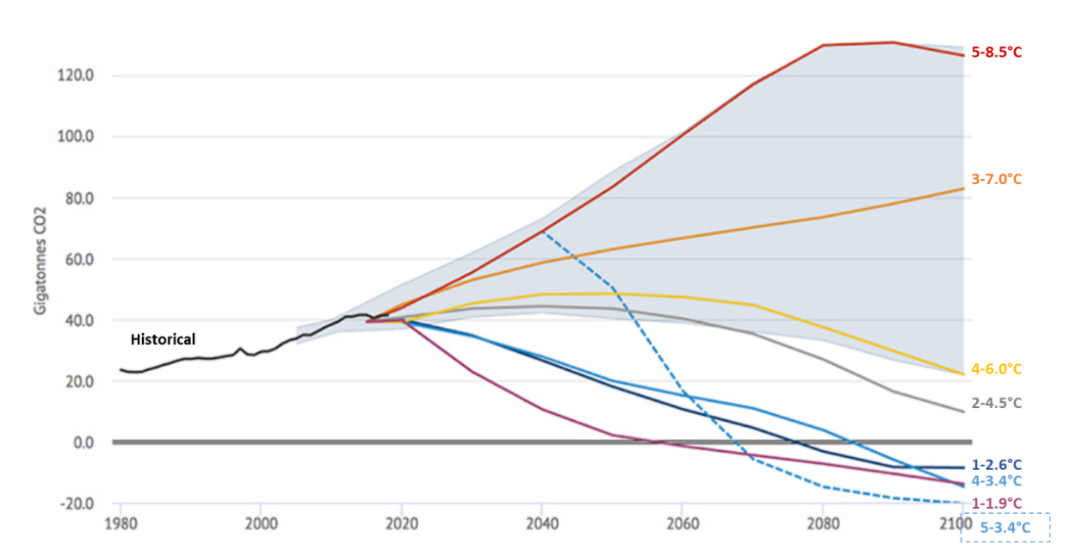
Global Action Is Urgently Needed
The magnitude of the challenge should not be underestimated
The planet has a “carbon budget” of 420 gigatonnes of carbon dioxide emissions for the 1.5°C scenario
At current levels of emissions, the entire carbon budget would be consumed within 8 years
Emissions must go to net zero, but the world is not on track
Temperature outcomes for various emissions futures
Source: Carbon Brief (2019).

Slide 5
Pathways to Net Zero Emissions
Samples of ambitious and aspirational
pathways to net zero
Pathways based on the world’s carbon budget, emissions reductions targets and timelines have been modelled and published by various organisations.
All published pathways include levels of nuclear energy deployment based on currently available commercial technologies
Nuclear innovation does not feature prominently because of a lack of specialised expertise in nuclear technologies among modelling teams
Organisation | Scenario | Parameter | 2020 | 2050 | Growth rate (2020-50)
IIASA (2021) | Divergent Net Zero Scenario (1.5°C) | Cost of carbon (USD per tCO₂) | 0 | 1 647 | -
 |  | Wind (in GWe) | 600 | 9 371 | 1461%
 |  | Solar (in GWe) | 620 | 11 428 | 1743%
IEA (2021) | Net Zero Scenario (1.5°C) | Hydrogen (MtH₂) | 90 | 530 | 490%
 |  | CCUS (GtCO₂) | <0.1 | 7.6 | -
 |  | Energy intensity (MJ per USD) | 4.6 | 1.7 | -63%
Bloomberg NEF (2021) | New Energy Outlook Green Scenario (1.5°C) | Wind (in GWe) | 603 | 25 000 | 4045%
 |  | Solar (in GWe) | 623 | 20 000 | 3110%

Slide 6
The Role of Nuclear Energy

Slide 7
The Full Potential of Nuclear Energy to Contribute to Emissions Reductions
Complementary nuclear technologies and applications
H₂
Long Term Operation
Large Gen-III Reactors
Small Modular Reactors
Non-Electrical applications

Slide 8
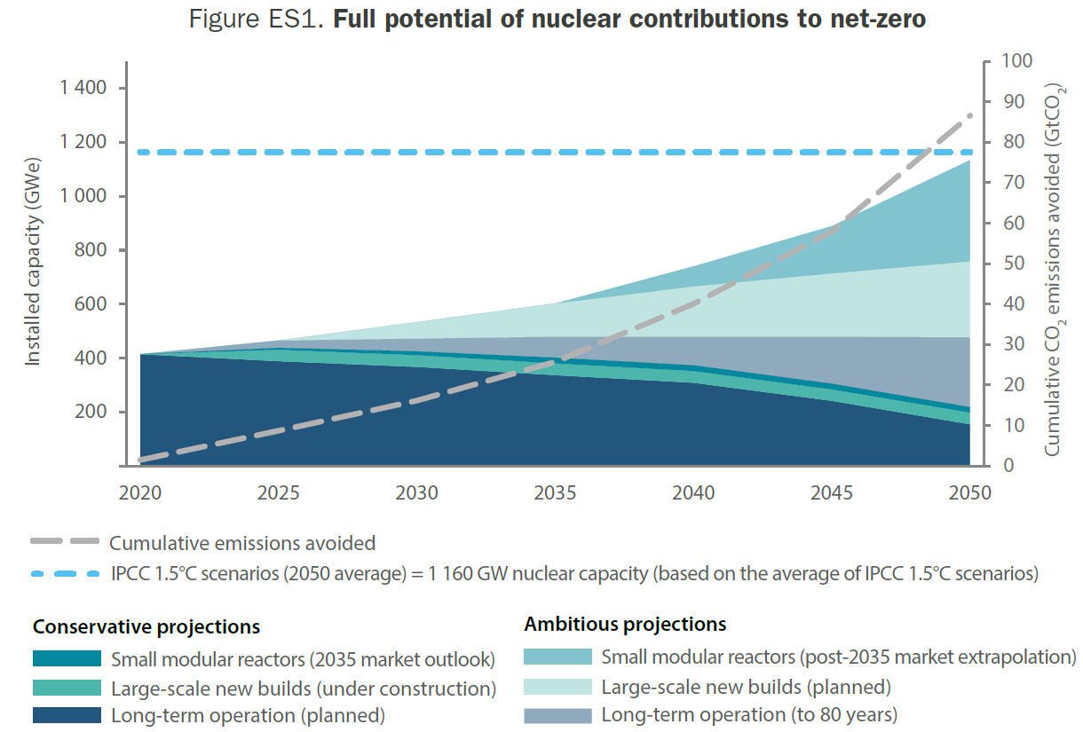
SMRs Have an Important Role to Play Alongside Long-term Operation and New Builds of Large Nuclear Power Plants
Full potential of nuclear contributions to Net Zero
Reaching the target of 1160 gigawatts of global installed nuclear capacity by 2050 will require a combination of long-term operation, large-scale Generation III, small modular reactors, and non-electric applications such as nuclear-produced heat and hydrogen.

Slide 9
3. Opportunities and Challenges

Slide 10
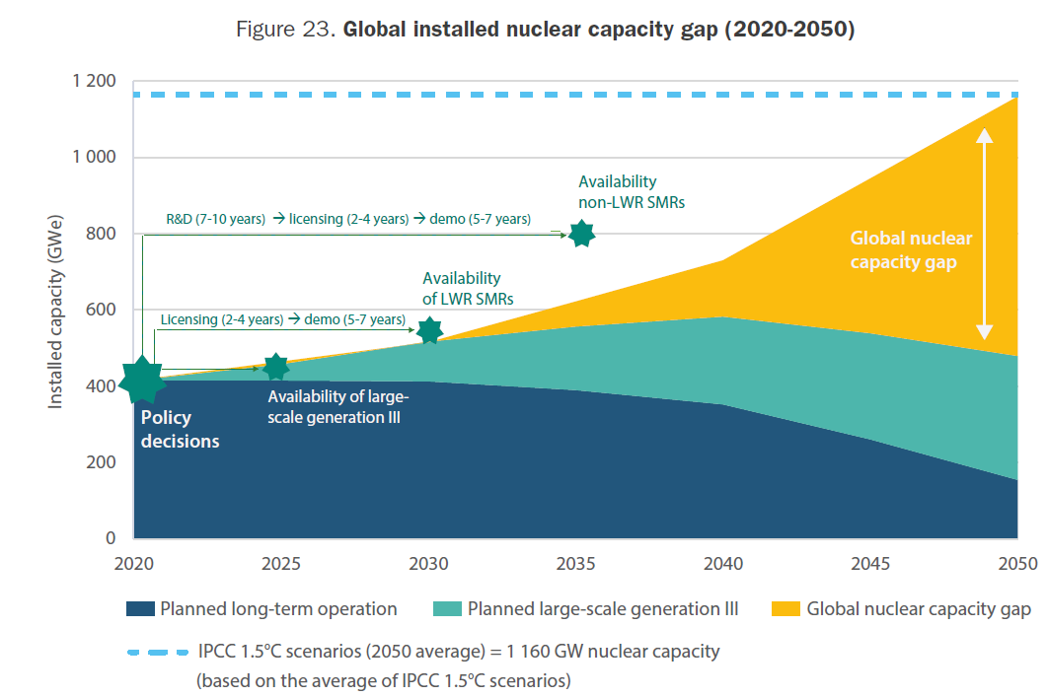
Global Installed Nuclear Capacity Gap
Global installed nuclear capacity gap (2020-2050)
Under current policy trends, nuclear capacity in 2050 is expected to reach 479 gigawatts – well below the target of 1160 gigawatts of electricity
Owing to the timelines for nuclear projects, there is an urgency to action now to close the gap in 2030-2050
Notes:
Further info:
50 more reactors are under construction, 100 additional reactors are planned
Nuclear is the second largest source of non emitting electricity following hydroelectricity
Source: PRIS - Home (iaea.org)

Slide 11
Nuclear Energy Faces Many Challenges
The nuclear sector must move quickly to demonstrate and deploy near-term and medium-term innovations including advanced and small modular reactors, as well as nuclear hybrid energy systems including hydrogen
There are key enabling conditions for success that the nuclear sector and energy policy-makers more broadly should address in the areas of system costs, project timelines, public confidence and clean energy financing
A systems approach is required to understand the full costs of electricity provision, and to ensure that markets value desired outcomes: low carbon baseload, dispatchability, and reliability
Rapid build-out of new nuclear power is possible, but requires a clear vision and plan
Building trust is central to building public confidence and requires sustained investments in open and transparent engagement as well as science communication. A common mistake is to assume that public confidence is primarily a communication issue
Governments have a role to play in all capital intensive infrastructure projects – including nuclear energy projects. This role can include direct funding, but also enabling policy frameworks that allow an efficient allocation of risks and for nuclear energy projects to compete on their merits on equal footing with other emitting energy projects

Slide 12
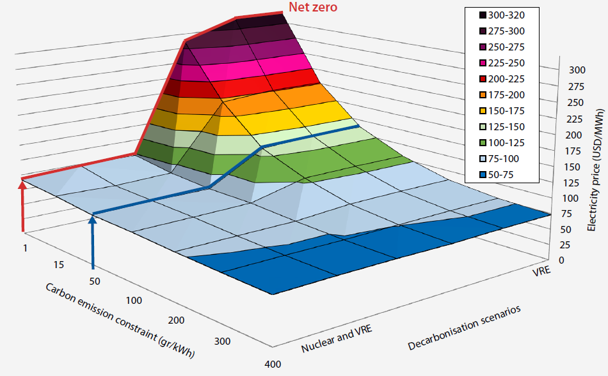
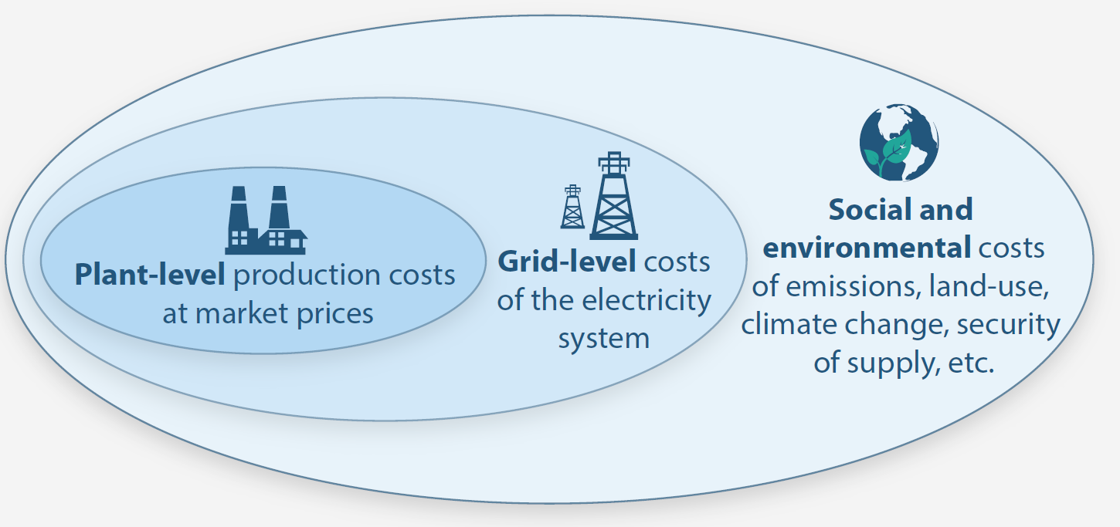
Understanding the costs of electricity provision
Understanding system costs of electricity
Total costs for different mixes of electricity (driving to net-zero)
To understand the costs of electricity provision requires systems level thinking combining plant-level costs, grid-level systems costs, and full social and environmental costs
This 3-dimensional graph shows the effects on total costs as carbon emissions are increasingly constrained. The red line shows what happens to total costs when carbon constraints reach net-zero emissions.

Slide 13
4. Recommendations

Slide 14
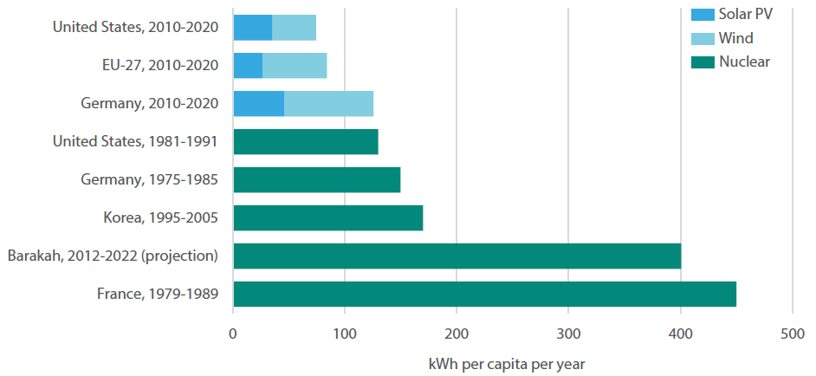
Recommendations
1._Acting now
Governments and industry should work together on an urgent basis to demonstrate and commercially deploy nuclear energy innovations
2. _Addressing timelines
Governments and industry should learn from successful examples of rapid deployment of nuclear to decarbonize electricity grids
Regulators should collaborate to harmonize licensing approaches to enable efficient fleet deployment of nuclear innovations across international boundaries
Average annual increase of low-carbon electricity per capita during decade of peak scale-up

Slide 15
Recommendations (continued)
3. _Understanding and reducing costs
The nuclear sector should draw from recommendations made in the NEA (2020) study Unlocking Reductions in the Construction Costs of Nuclear: A Practical Guide for Stakeholders to ensure that the sector meets cost objectives
Governments should take a systems level perspective when developing electricity policies to ensure that markets adequately value key nuclear features such as low carbon baseload, dispatchability, and reliability
4. _Building public confidence
Governments and industry should engage the citizenry to build trust and public confidence, ensuring that public dialogues about energy options are evidence-based. This involves addressing misinformation and ensuring that a realistic conversation about the pros and cons of various options is facilitated
5. _Financing and investing
Governments should make investments in nuclear energy and support a technology neutral approach that includes nuclear energy in taxonomies, climate finance, development finance, and ESG finance

Slide 16
Thank you for your attention

