Slide 1
Nuclear Energy’s Potential to Replace Fossil Fuels
IFNEC NSCCEG Webinar: Opportunities and challenges for nuclear energy in the context of carbon neutrality
15 September 2022
Aliki van Heek
Unit Head 3E Analysis
International Atomic Energy Agency

Slide 2
Nuclear Energy for a Net-Zero World: selected messages
Nuclear power plants are well suited to replace coal-fired power plants for low emissions electricity generation.
Nuclear power can also substitute coal fired boilers for district heating and industry.
Nuclear energy can provide low carbon hydrogen for hard-to-abate sectors via both established and emerging production processes.
IAEA, 2021
2

Slide 3
Presentation outline
Energy consumption
Replacement potential
Moving away from coal
Replacing fossil fuels: hydrogen
3

Slide 4
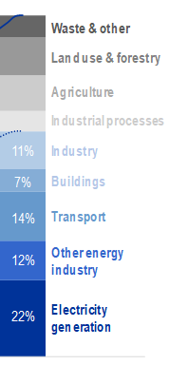
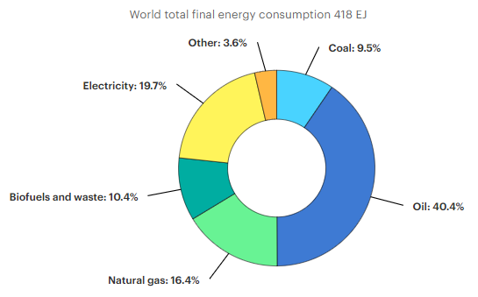
Energy consumption by fuel and by sector
energy
IAEA Climate Change and Nuclear Power 2020
www.iea.org
4

Slide 5
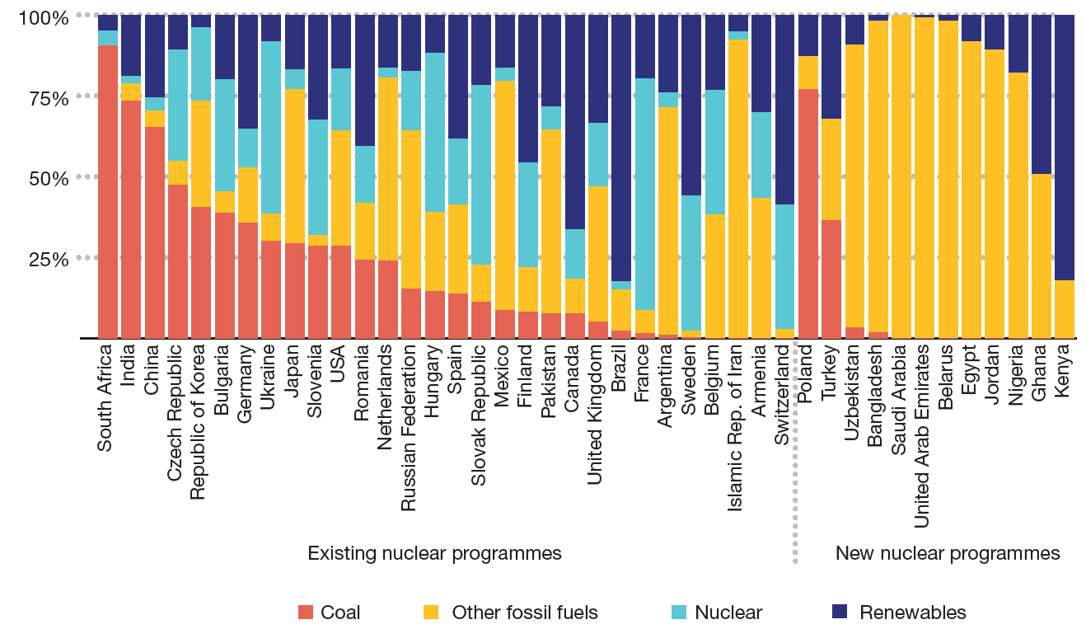
Replacement potential in ‘nuclear’ countries
Electricity generation mix (2018) in countries with or planning nuclear power programmes
Based on data from IEA, World Energy Statistics and Balances, Paris, 2021.
5
Notes:
Climate mitigation is urgent: focus on nuclear countries and countries with new nuclear programmes.

Slide 6
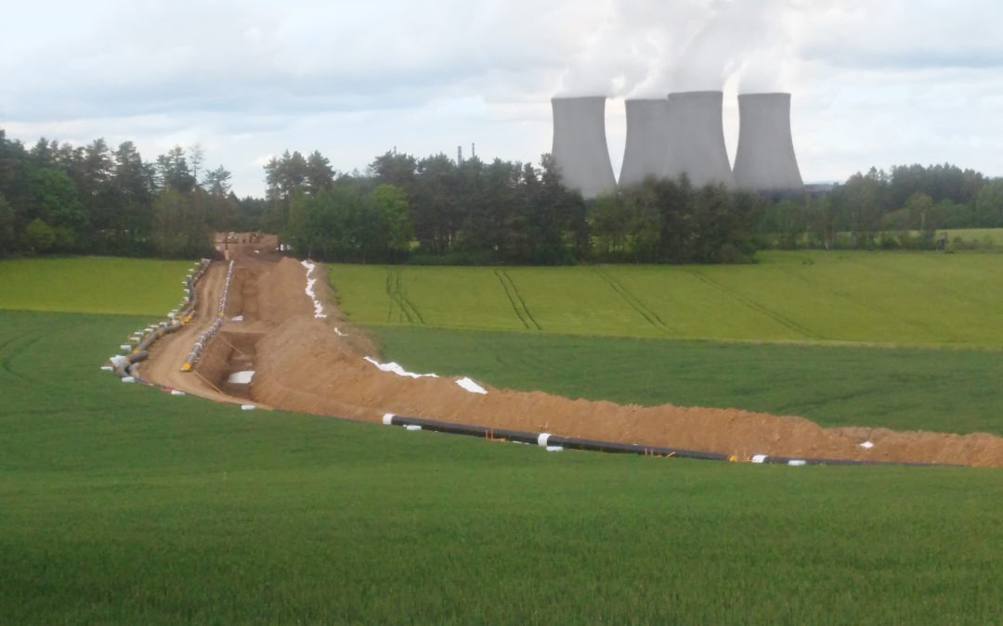
Moving away from coal: country case
Temelín Nuclear Power Plant, Czech Republic:
Existing heat distribution system extended to town of Tyn nad Vltavou: helped to eliminate 22 medium sized coal fired heating plants and 3 large boiler facilities
Extension to town of Ceske Budejovice (Budweis):
will supply heat to 30,000 inhabitants
contribute about 1/3 of the city’s total heat supply,
saving about 80 kt CO2 each year for at least 30 years.
6

Slide 7
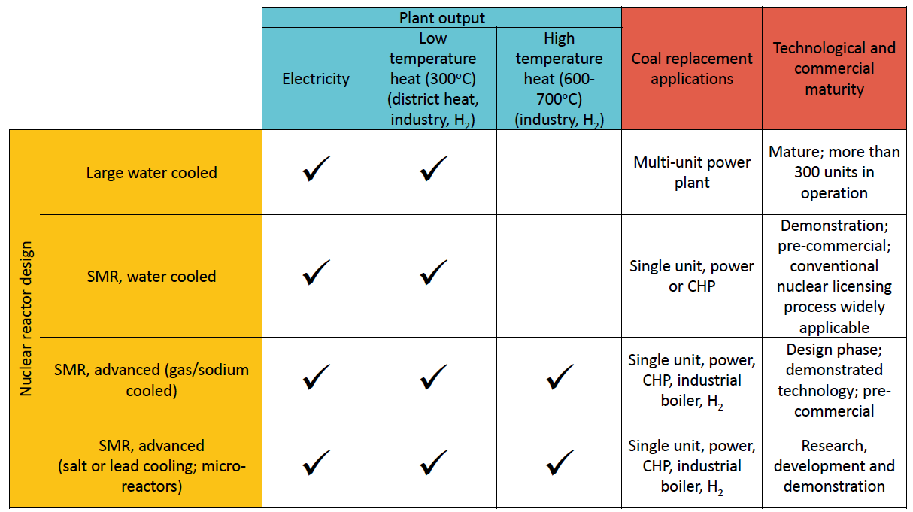
Moving away from coal: nuclear options
Categories of nuclear technologies for replacing coal
SMR = Small Modular Reactor
7

Slide 8
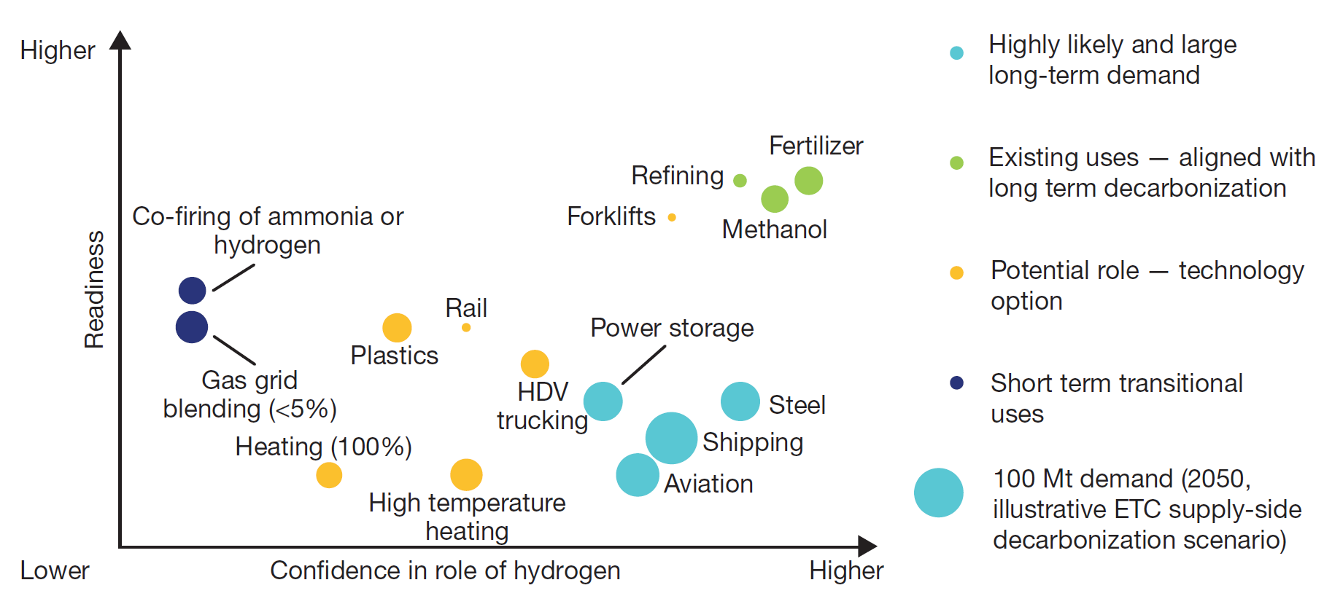
Replacing fossil fuels: hydrogen
Potential uses of hydrogen in a low carbon economy
Energy Transitions Commission, Making the Hydrogen Economy Possible, London, 2021
8
Notes:
Not only coal, also oil and gas

Slide 9
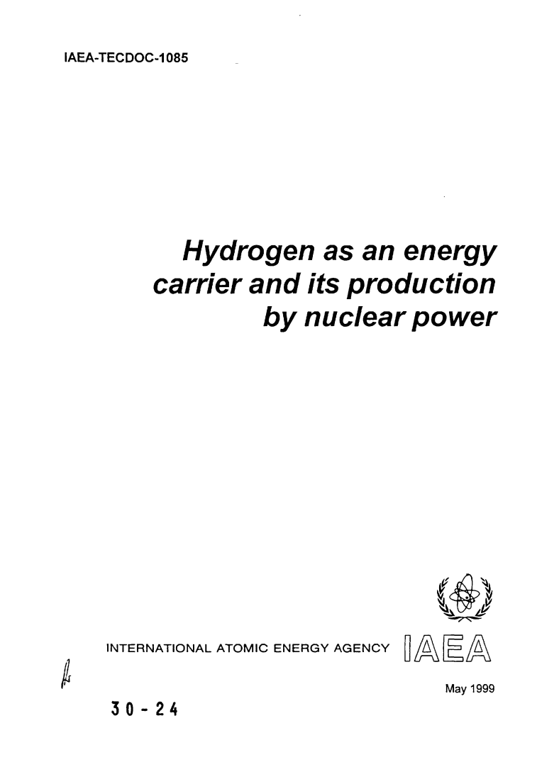
Replacing other fossil fuels: hydrogen
Hydrogen production using existing NPPs
IAEA, Building the Business Case for Hydrogen Production with Operating Nuclear Power Plants, to be published, 2022
9
Notes:
Nuclear hydrogen researched for a long time
Connect to existing utilities: 10 NPP projects

Slide 10
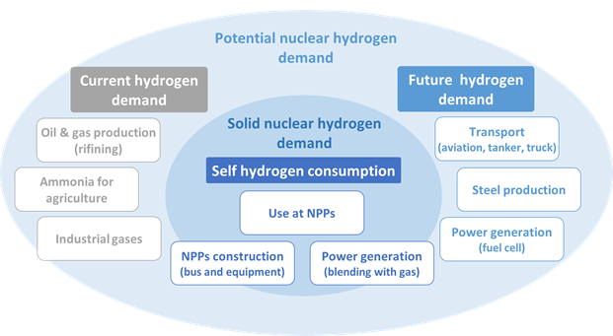
Replacing other fossil fuels: hydrogen
Hydrogen uses for currently operating NPP
10

Slide 11
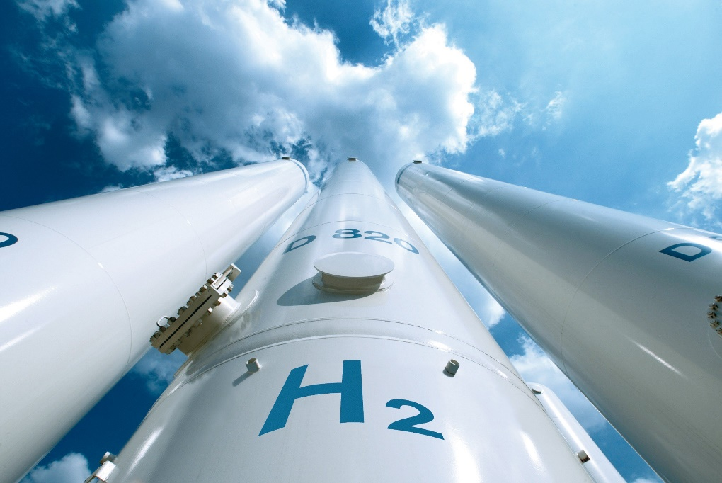
Replacing other fossil fuels: hydrogen
Observed project differences:
In search for markets, each utility targets different demands.
Different electrolyser technology selected for each project, with no clearly defined superior technology to date.
Electrolyzer location:
near NPPs when hydrogen is used primarily in NPPs only as step towards commercial H₂ production,
near hydrogen demand facilities when hydrogen is used by a large demand facility such as thermal gas power plants or a steel production plant.
But for all nuclear hydrogen projects:
Government support such as government funding and inclusion in national hydrogen strategies has shown to be key to nuclear hydrogen project success.
11
Notes:
Each utility targets different demands, but faces the same challenge of finding a market where they can secure a reliable revenue stream for their hydrogen development projects.

Slide 12
Thank you for your attention!

